Slide 1
Globally Harmonized System’s (GHS) Classification and Labeling of Chemicals Hazard Communication Standard (HCS)

Slide 2
Globally Harmonized System
The following slides contain information you should know regarding OSHA’s updated Hazard Communication Standard (HazCom 2012) and the Globally Harmonized System of Classification and Labeling of Chemicals (GHS).

Slide 3
GHS and HazComm
HazCom 2012: OSHA standard 29CFR 1910.1200, modified in 2012 to state that the United States will abide by and train on the new GHS criteria, including Hazard Classifications, Labels, Safety Data Sheets (SDS) and Training
GHS: provides a single set of harmonized criteria for classifying chemicals according to their health and physical hazards; specifies required hazard communication elements and formats for labeling and Safety Data Sheets (SDS)

Slide 4
GHS
The official guide to the new Hazard Communication Standard (HazCom 2012) is called the The Purple Book:
The Globally Harmonized System of Classification and Labelling of Chemicals (GHS)
and may be found on OSHA’s website:
http://www.osha.gov/dsg/hazcom/ghs.html
********************
OSHA’s video explaining these changes: http://www.youtube.com/watch?v=RvQNf1Y7E84

Slide 5
GHS and HazComm
From the Purple Book, the reason OSHA is adopting this new system:
It is anticipated that application of the GHS will:
Enhance the protection of human health and the environment by providing an internationally comprehensible system
Provide a recognized framework to develop regulations for those countries without existing systems
Facilitate international trade in chemicals whose hazards have been identified on an international basis
Reduce the need for testing and evaluation against multiple classification systems
The tangible benefits to governments are:
Fewer chemical accidents and incidents
Lower health care costs
Improved protection of workers and the public from chemical hazards
Avoiding duplication of effort in creating national systems
Reduction in the costs of enforcement
Improved reputation on chemical issues, both domestically and internationally

Slide 6
GHS and HazComm
cont. - From the Purple Book, the reason OSHA is adopting this new system:
Some of the benefits to companies listed in the Purple Book include:
safer work environment
increased efficiency
maximize expert resources
reduced costs due to fewer accidents and illnesses
improved corporate image and credibility
Benefits to workers and members of the public include:
improved safety through consistent and simplified communications on chemical hazards and practices
greater awareness of hazards, resulting in safer use of chemicals

Slide 7
GHS and HazComm
The reason OSHA is adopting this new system:
Facts about GHS:
It was developed by the United Nations as a way to collaborate agreement on chemical regulations and standards with participating countries.
It is hoped that GHS will make international sale and transportation of hazardous chemicals easier and make workplace conditions safer.
U.S. officially adopted GHS on March 26, 2012. OSHA’s adoption is actually a revision of the HCS to align with GHS. OSHA calls this revision HazCom 2012.
GHS is not a global law or regulation, but a set of recommendations or collection of best practices. No country is obligated to adopt all or any part of the GHS. Countries can pick and choose which parts of the GHS they wish to incorporate into their own regulations, and they are responsible for its enforcement.
To date, over 65 countries have adopted GHS or are in the process of doing so.
Biggest changes for those adopting GHS will be safety labels, SDSs, and chemical classification.
Biggest costs to businesses is to re-classify all chemicals using GHS criteria and train workers on these changes.

Slide 8
GHS and HazComm
The reason OSHA is adopting this new system:
Facts about GHS (cont.):
GHS is meant to be a logical and comprehensive approach to:
Defining health, physical and environmental hazards of chemicals (although environmental hazards are outside OSHA’s jurisdiction)
Creating classification processes that use available data on chemicals for comparison with the defined hazard criteria
Communicating hazard information in a prescribed and uniform way on labels and SDS
In the U.S., GHS adoption is under the domain of OSHA, EPA, DOT and Consumer Product Safety Commission (CPSC).
DOT was actually the first agency to implement GHS; OSHA’s adoption brings the regulations between these two agencies into greater harmony. EPA is expected to quickly follow with revisions to its standards to align them with GHS.

Slide 9
GHS
Standardizes:
1. Hazard classification
2. Labels
manufacturers’ labels
secondary or workplace (secondary to the original container) labels
3. Safety Data Sheets (SDS) – formerly called Material Safety Data Sheets (MSDS)

Slide 10
GHS – Containers Received
Labels are more prescriptive, and include six standard elements:
1. Product Identifier (chemical name) matching the product identifier on the SDS
2. Suppler Information including name, address and phone number of responsible party
3. Signal Word, either “Danger” or “Warning” depending upon severity
4. Pictogram(s), black hazard symbols on white background with red diamond borders that provide a quick visual reference of hazard information
5. Hazard Statement(s) that describe the nature of the hazard and/or its severity
6. Precautionary Statement(s) that provide important information on the safe handling, storage and disposal of the chemical

Slide 11
GHS

Slide 12
GHS - Pictograms
Skull and Crossbones
Acute Toxicity (fatal or toxic)
Gas Cylinder
Gases Under Pressure
Exploding Bomb
Explosives
Self Reactives
Organic Peroxides
Environment (Non-Mandatory)
Aquatic Toxicity
Flame Over Circle
Oxidizers
Exclamation Mark
Irritant (skin and eye)
Skin Sensitizer
Acute Toxicity
Narcotic Effects
Respiratory Tract Irritant
Hazardous to Ozone Layer (Non-Mandatory)
Corrosion
Skin Corrosion/Burns
Eye Damage
Corrosive to Metals
Health Hazard
Carcinogen
Mutagen
Reproductive Toxicity
Respiratory Sensitizer
Target Organ Toxicity
Aspiration Toxicity
Flame
Flammables
Pyrophorics
Self-Heating
Emits Flammable Gas
Self Reactives
Organic Peroxides

Slide 13
GHS – Workplace (Secondary) Labels
Secondary containers MUST have labels (chemical name) and a hazard label identifying its hazard. Use one of the nine pictograms on the right; alternately, a National Fire Protection Association (NFPA) diamond or Hazardous Material Identification System (HMIS) sticker may still be used for this.
OSHA (DNR, EPA) may fine without these two pieces of information.
OSHA dictates that SDSs will use the sanctioned pictograms to communicate the chemical’s hazard.

Slide 14
GHS – Labels, confusing anomaly?
(From MSDSonline article titled “NFPA, HMIS and OSHA’s GHS Aligned Hazard Communication Standard”)
“An important difference between NFPA/HMIS systems and GHS/HazCom 2012 is the way they use numbers. The numbers in the GHS system, as adopted by OSHA, do not show up on the label, instead they are used to determine what goes on the label. The numbers do appear on GHS formatted safety data sheets, in Section 2, but OSHA believes the use of numbers there will be less confusing since there is much more contextual information available to help the reader understand the hazard information. In the NFPA and HMIS systems, the numbers themselves appear on the label and are used to communicate information about the hazard.”

Slide 15
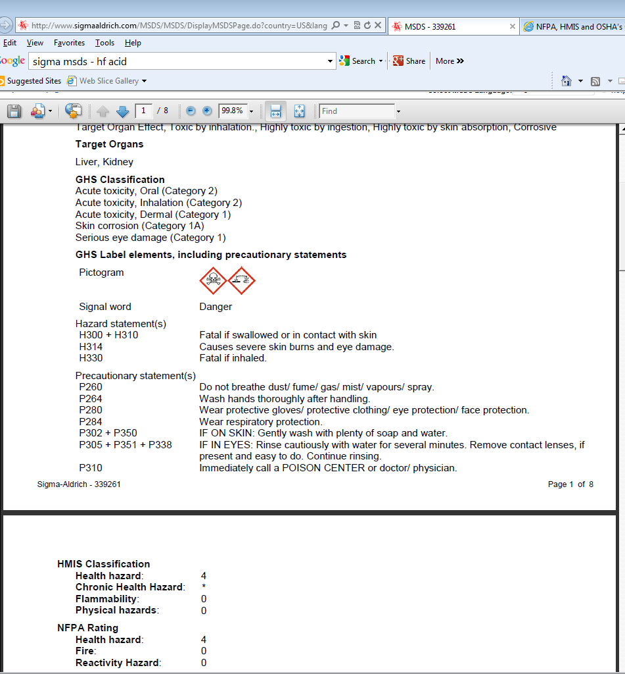
GHS – Labels, confusing anomaly?
Part of section 2 from Sigma-Aldrich’s SDS for Hydrofluoric Acid
Note the difference between GHS Classification and HMIS and NFPA
GHS: the lower the categorization number, the greater the severity of the hazard. No numbers on the labels.
NFPA and HMIS: the higher the number, the greater the severity. Number are on the labels.
NFPA diamond for HF:
HMIS Sticker:

Slide 16
GHS – Workplace (Secondary) Labels
To test for compliance in secondary labeling answer these two questions:
What is this chemical (chemical name)?
What are the hazards of this chemical?
Make sure you know your system for labeling secondary containers. This system should be standard throughout your department.

Slide 17
GHS – SDS
Keep SDSs for 30 years, whether or not you still have the chemical.

Slide 18
GHS – SDS
Keep SDSs for 30 years, whether or not you still have the chemical.

Slide 19
GHS – SDS
Chemicals in your lab – KEEP A CURRENT INVENTORY
Employees must know the system used in their workplace. At S&T we use on-line resources and hard copy.
When searching online for a SDS be sure to search on the chemical’s manufacturer’s website.
For very hazardous chemicals (example – hydrofluoric acid) have a hard copy in your laboratory.
SDS must be readily accessible in a known location.
For general searches, links to SDS search addresses are available through Environmental Health & Safety’s home page and Chemtrack.

Slide 20
GHS: Changes Required to be Implemented

